Slide 1
National Adaptation Plan
Issues Paper
Public Webinar
Kathryn Smith
Branch Head
National Adaptation Policy Office
26 March 2024

Slide 3
Contents
Overview of climate change in Australia
Agreed roles and responsibilities for adaptation
Climate adaptation in Australia: where are we at?
Addressing priority risks from the National Climate Risk Assessment
What's in the National Adaptation Plan Issues Paper?
About the National Adaptation Plan
Q&A

Slide 4
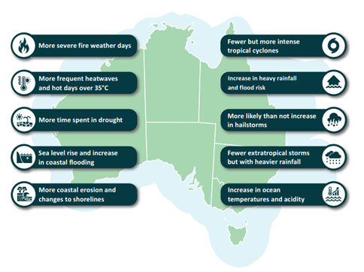
Overview of Climate Change in Australia
Source: National Climate Risk Assessment – First Pass Assessment Report, Figure 1, p.3

Slide 5
The Australian context: agreed roles and responsibilities for adaptation
The Australian Government's role includes:
providing national leadership on adaptation
providing nationally authoritative climate science and information
managing Australian Government assets and services
maintaining a strong, flexible economy and a well targeted social safety net.
State, territory and local government roles include:
delivering a broad range of services
administering a significant body of legislation
managing a substantial number of assets and infrastructure
planning and managing use of crown land.
Source: Council of Australian Governments 2012, Roles and Responsibilities for Climate Change Adaptation in Australia

Slide 6
Climate adaptation in Australia: where are we at?
Action is already underway across governments, households, industry, business and community organisations to help Australia adapt.
The Australian Government is investing $28 million over 2 years to deliver the National Climate Adaptation and Risk Program, including Australia's first National Climate Risk Assessment and National Adaptation Plan
Once finalised, the National Adaptation Plan will supersede the National Climate Resilience and Adaptation Strategy 2021-25

Slide 7
The Adaptation Plan will address priority risks from the National Climate Risk Assessment
The first pass report released with the Issues Paper identifies 56 nationally significant climate risks facing Australia.
11 risks have been assessed as priority risks and are being examined in the second stage of work this year. These will be the focus of the Adaptation Plan
The priority risks cover the natural environment; primary industries and food; regional and remote communities; health and social support; infrastructure; defence and national security; communities and settlement; water security; supply chains; economy, trade and finance; and governance.
In 2023, the National Climate Risk Assessment first pass involved 3 main elements: a literature review, an adaptation stocktake and expert elicitation.
The first pass of the Risk Assessment has been produced in collaboration with a range of stakeholders including all levels of government, non-government organisations, industry, academia, and First Nations peoples. This involved over 250 stakeholders and a series of workshops across the country.

Slide 8
So what’s in the National Adaptation Plan Issues Paper?
The Issues Paper includes:
Context for the adaptation plan, including the roles of different levels of government and the private sector in adaptation
Proposed foundations for the plan
A look at climate risk and adaptation across 8 key systems, including a summary of action already underway and possible future directions for mainstreaming adaptation
Questions for consultation

Slide 9
About the National Adaptation Plan
The National Adaptation Plan will establish a framework for adaptation and outline an approach to addressing the priority nationally significant, physical climate risks faced by Australia.
We expect the Plan would be used by:
Australian Government agencies to undertake adaptation action
other levels of government, business and community groups, to understand the national context and framework for adaptation planning in which their own plans are made.

Slide 10
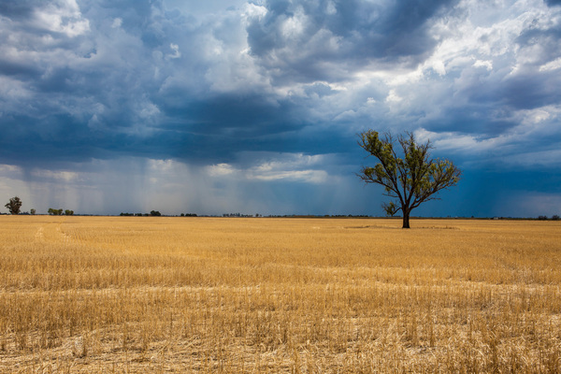
What the National Adaptation Plan is not
The National Adaptation Plan will not
replace or duplicate more detailed adaptation plans for other levels of government, sectors, or systems
duplicate disaster management planning and systemic resilience policy, which is led by NEMA, and other agencies under the Australian Government Crisis Management Framework
address ‘transition risks’ from the transition to a net zero emissions economy, including technological changes, policy shifts or changes in consumer preferences.

Slide 11
Foundations for a National Adaptation Plan
As a starting point for feedback, the department has developed a draft vision and objective for the plan:
The proposed key objectives of the adaptation plan are to:
mainstream adaptation action
drive a substantial uplift in private sector investment
establish support for people and communities in disproportionately vulnerable situations.
Australia’s economy, society, and natural and built environments are being managed and invested in, to reduce climate impacts and harness any opportunities now and into the future – by all levels of government, business and community.

Slide 12
How might we prioritise adaptation actions?
The issues paper includes draft principles for prioritising adaptation actions, preferencing those that:
are ‘no regrets’ actions. These could be because they are addressing impacts expected with high likelihood in the next decade or have co-benefits (such as reducing emissions or reducing inequality)
are the first part of an effective adaptation pathway. That is, they manage the impacts expected in the short term, but are deployed in a way that makes it easier to respond to greater risks in the future
are key enabling actions for others, for example the provision of next generation regional climate projections, or guidance to support effective climate risk management
drive action to strengthen adaptation across multiple sectors or regions
promote consistency across the country, while allowing for local differences, including contexts and priorities
assist groups who are disproportionately affected by climate impacts and ensure that adaptation addresses equity and human rights, such as gender-responsive adaptation, intergenerational equity and equity for people with a disability.

Slide 13
What’s next?
Consultation on the issues paper will run until 11 April 2024.
This consultation will inform the draft national adaptation plan to be released Q3 2024 for public comment.
https://consult.dcceew.gov.au/climate-adaptation-in-australia-national-adaptation-plan-issues-paper

Slide 14
Thank you! Questions?
Learn more and stay updated:
Visit https://consult.dcceew.gov.au/climate-adaptation-in-australia-national-adaptation-plan-issues-paper to read the National Adaptation Plan Issues Paper and to Have Your Say
Visit the dedicated National Climate Risk Assessment and National Adaptation Plan webpage: https://www.dcceew.gov.au/climate-change/policy/adaptation/ncra
Connect with us:
For questions or suggestions on the National Adaptation Plan, please contact the National Adaptation Policy Office at climate.adaptation@dcceew.gov.au
For questions or suggestions on the National Climate Risk Assessment, please contact: NCRA@dcceew.gov.au
14

Slide 15
National Adaptation Plan
Issues Paper
For questions or suggestions on the National Adaptation Plan, please contact the National Adaptation Policy Office at climate.adaptation@dcceew.gov.au

